Slide 1

Loan eligibility Prediction
By using python jupyter notebook
Represented By
Dhanashri Sontakke

Slide 2


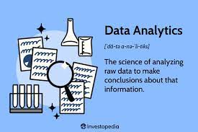
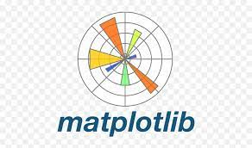

Content
Understanding the problem statement
About the dataset
Load essential Python Libraries
Load Training/Test datasets
Data Preprocessing
Exploratory data analysis (EDA).
Feature Engineering.
Build Machine Learning Model
Make predictions on the test dataset
Prepare submission file
Conclusion

Slide 3
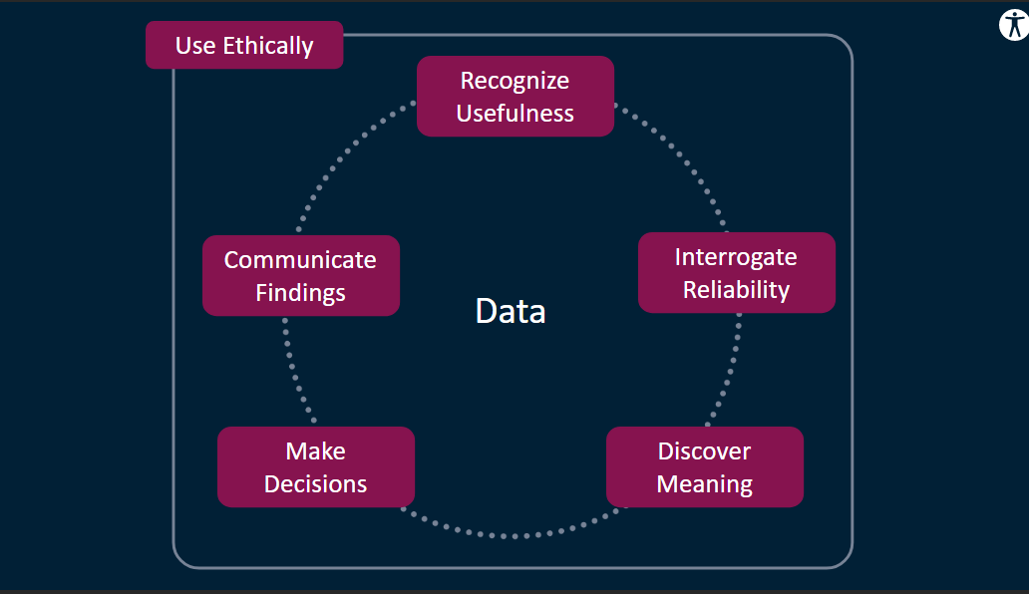

Slide 4
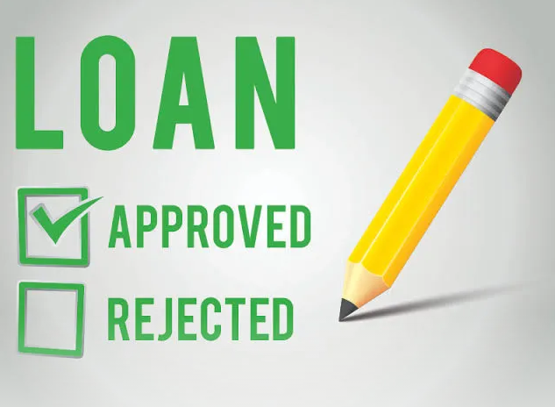
Problem Statement:
Design and implement a loan approval prediction system for a bank to determine whether a loan should be approved or not for a given person.
The goal of the system is to accurately predict the creditworthiness of an individual or organization to mitigate the risk of defaults and ensure that loans are assigned to the right borrowers.

Slide 5

About loan Eligibility Prediction
Criteria
Loan eligibility is defined as set of criteria basis which a financial institution evaluates to decide the eligibility of a customer for a particular loan.
Loan amount
Marital status
Applicant income
Co-applicant income
Loan amount term
Gender
Credit history
Property area
Loan amount
Applicant income
Property area
Marital status
Gender
Credit history
Co-applicant income

Slide 6
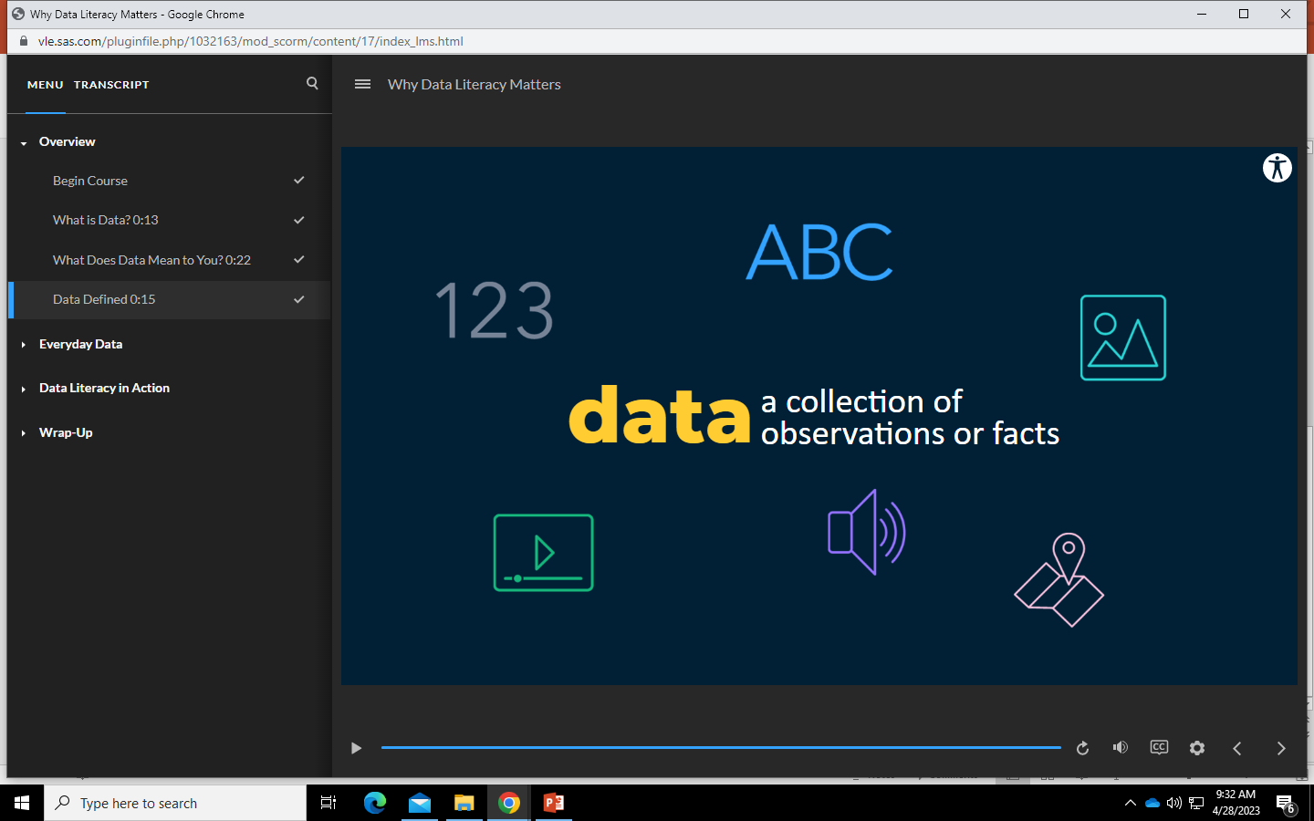
Introduction
Data Collection and Preprocessing
Feature Selection
Model Selection and Training
Model Evaluation and Optimization
Conclusion

Slide 7

Data Collection and Preprocessing
The first step in predicting loan approval is to collect and preprocess the data. This involves gathering data , as well as information about the applicants and their history.
Once the data has been collected, it must be preprocessed to ensure that it is in a format that can be used by the machine learning algorithms. This includes cleaning the data, handling missing values, and encoding categorical variables.

Slide 8

Feature Selection
After the data has been preprocessed, the next step is to select and features that are relevant to the loan approval process. This involves identifying which variables are most important in determining whether a loan will be approved or not.
Feature engineering also involves creating new variables that may be useful in predicting loan approval. For example, combining two variables .

Slide 9
conclusion after feature selection
We can infer that percentage of married people who have got their loan approved is higher compared to non- married people.
The percentage of applicants with either 0 or 2 dependents have higher loan approval.
The percentage of applicants who are graduates have higher loan approval than the ones who are not graduates.
Even after the data analysis, there is still no unique factor to determine loan status.

Slide 10

Model Selection and Training
Once the features have been selected and engineered, the next step is to choose a machine learning algorithm that is best suited for the task of loan approval prediction. There are several algorithms to choose from, including logistic regression, decision trees, and random forests.
After selecting the algorithm, the model must be trained using the preprocessed data. This involves splitting the data into training and testing sets, fitting the model to the training data, and evaluating its performance on the testing data.

Slide 11

Model Evaluation and Optimization
Once the model has been trained, its performance must be evaluated to determine its accuracy in predicting loan approval.
If the model's performance is not satisfactory, it can be optimized by adjusting its hyper parameters or by using a different algorithm. The optimization process involves fine-tuning the model until its performance meets the desired level of accuracy.

Slide 12

Conclusion
In conclusion, the prediction of loan approval using Python and machine learning algorithms is a powerful tool for the banking industry. By collecting and preprocessing data, selecting and engineering features, selecting and training a model, and evaluating and optimizing its performance, loan approval can be predicted with high accuracy.
This technology has the potential to revolutionize the loan approval process, making it faster, more efficient, and more accurate than ever before.

Slide 13


